Slide 1
MA 201
APPLICATI0NS OF SECOND ORDER ORDINARY DIFFERENTIAL EQUATIONS

Slide 2
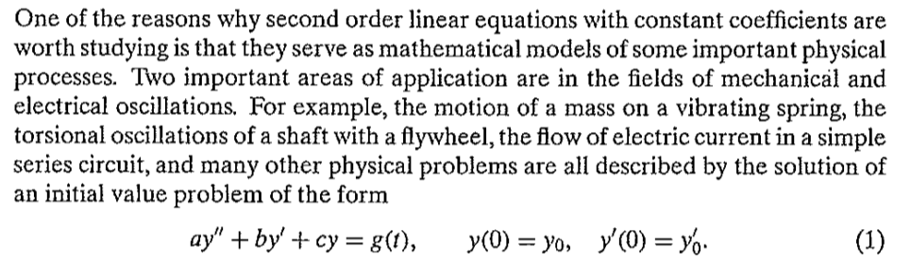
Mechanical and electrical vibrations

Slide 3
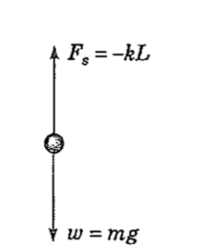
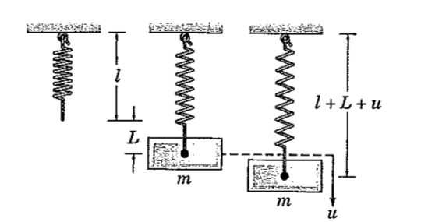
Fig: 3.8.1: A spring mass system
Fig: 3.8.2: Force Diagram for a spring mass system.

Slide 4
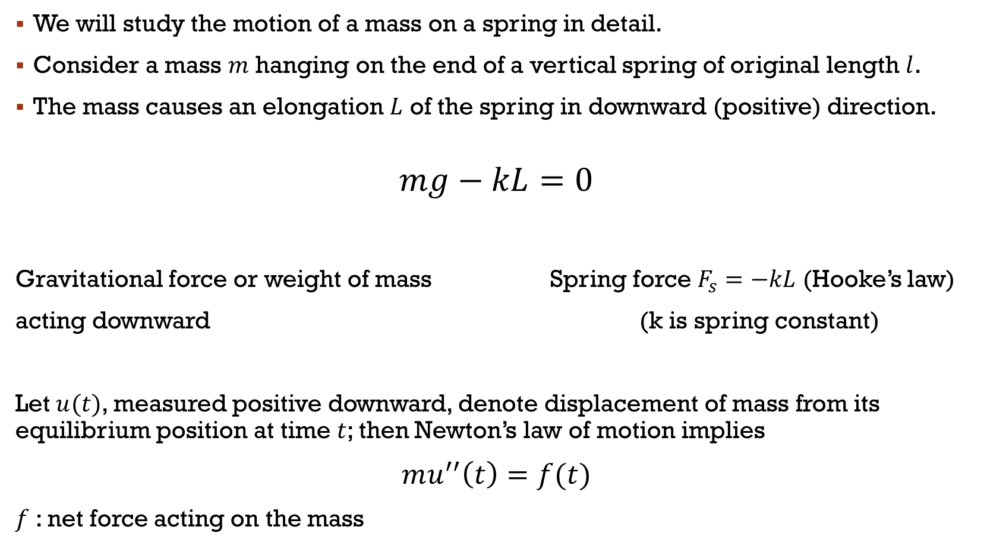
We will study the motion of a mass on a spring in detail.
Consider a mass $m$ hanging on the end of a vertical spring of original length $l$.
The mass causes an elongation $L$ of the spring in downward (positive) direction.
$$mg−kL=0$$
Gravitational force or weight of mass Spring force $F_{s}=−kL$ (Hooke’s law)
acting downward (k is spring constant)
Let $u(t)$, measured positive downward, denote displacement of mass from its equilibrium position at time $t$; then Newton’s law of motion implies
$mu^{′′}\left(t\right)=f(t)$
$f$ : net force acting on the mass

Slide 5
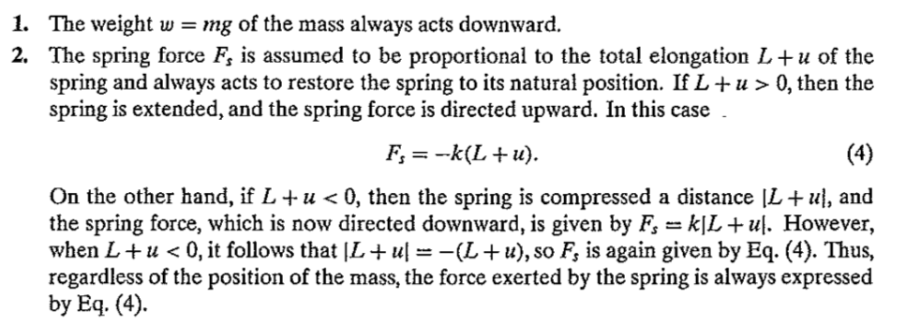

In determining $f$, there are four separate forces that must be considered:

Slide 6
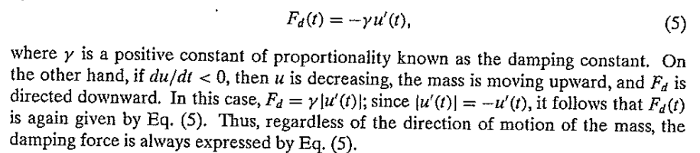
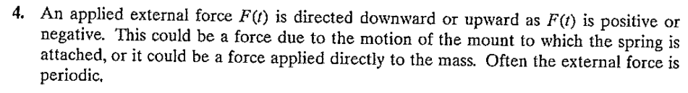
This force may arise from several sources : resistance from air or other medium in which the mass moves, internal energy dissipation due to extension or compression of spring etc.

Slide 7
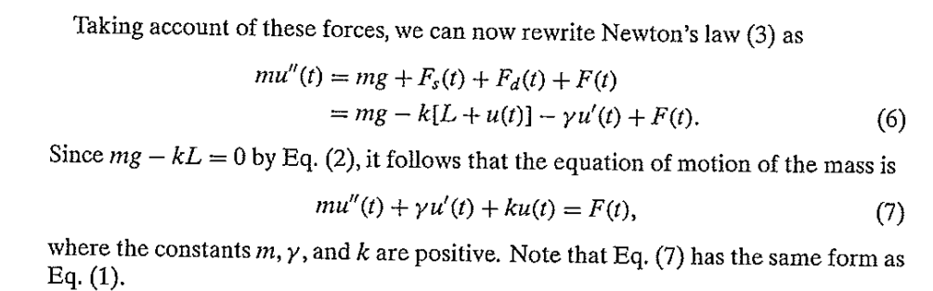
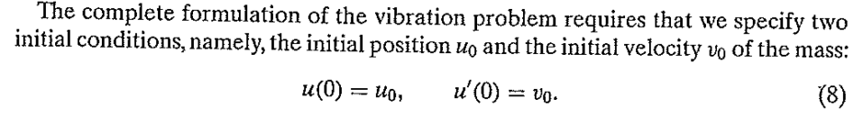
THE POSITION OS MASS IS GIVEN (APPROXIMATELY) BY THE SOLUTION OF EQ. (7) SUBJECT TO THE PRESCRIBED INITIAL CONDITIONS (8).

Slide 8
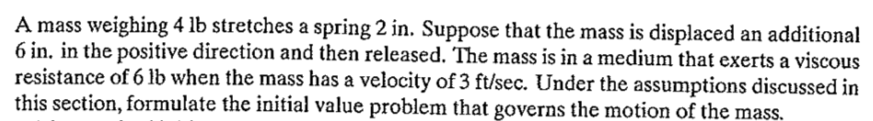
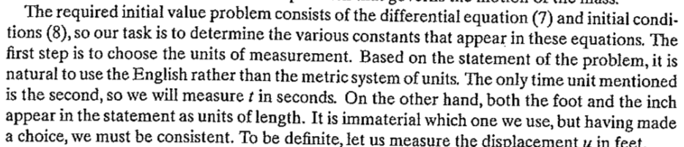
Example:

Slide 9
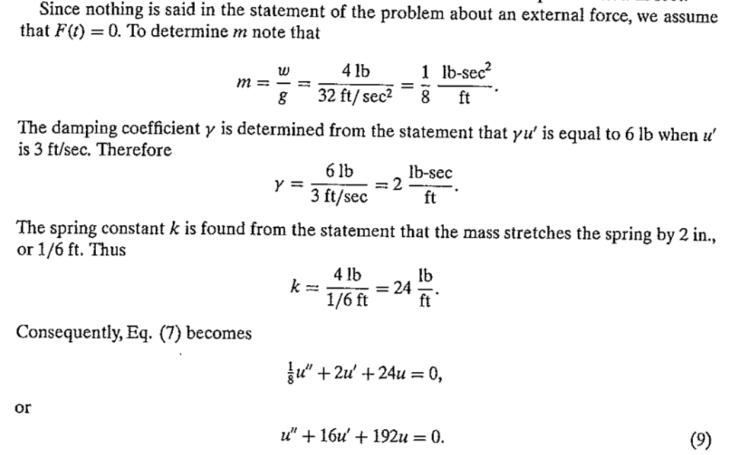

Slide 10
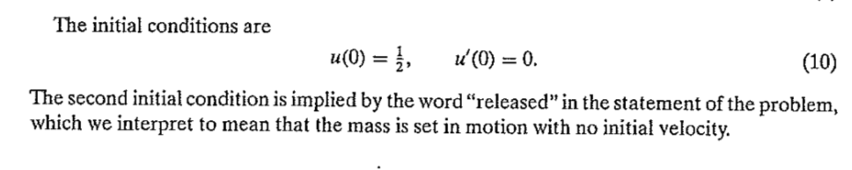

Slide 11
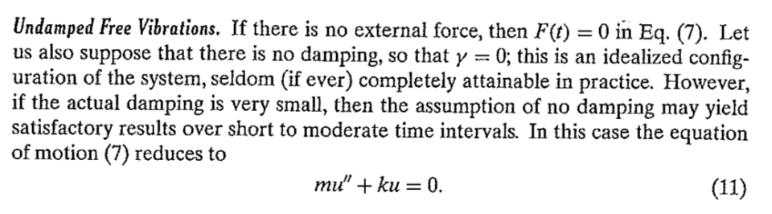
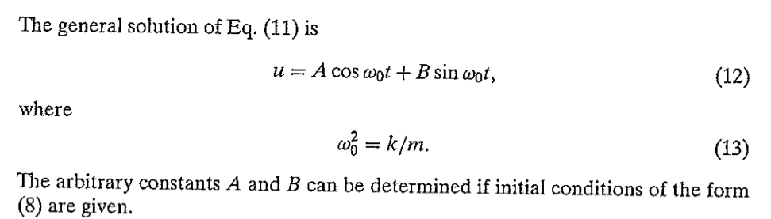

Slide 12
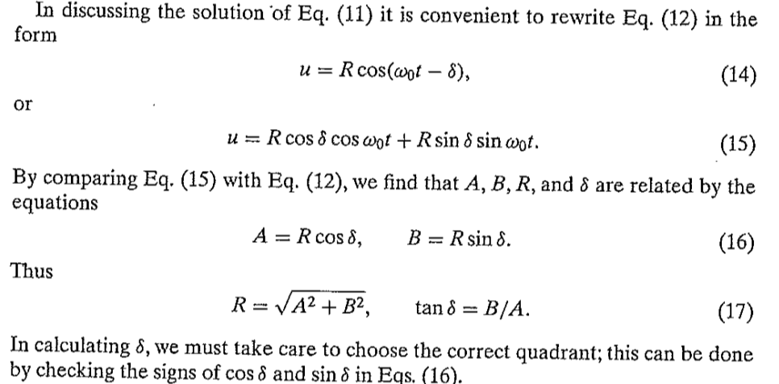

Slide 13
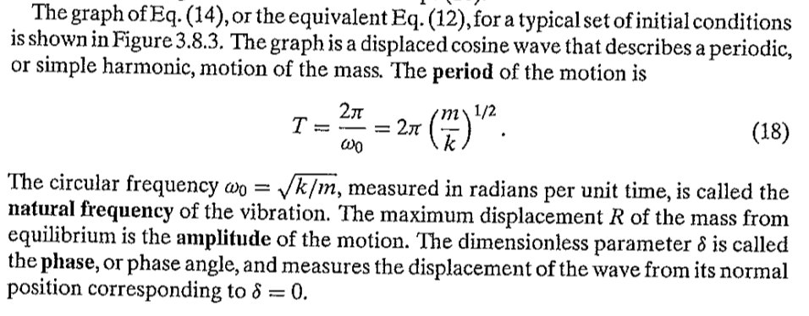
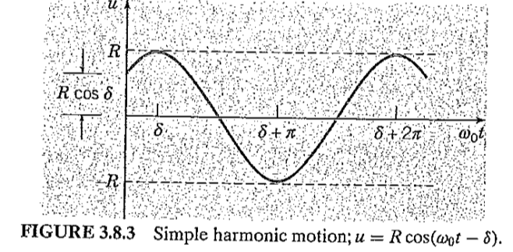



Slide 14

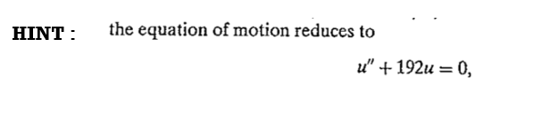
Example
HINT :

Slide 15
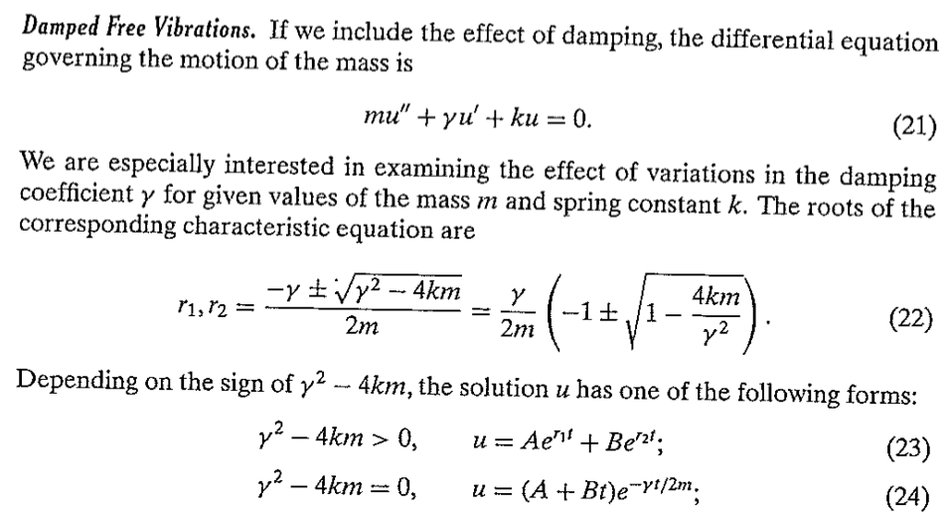

Slide 16
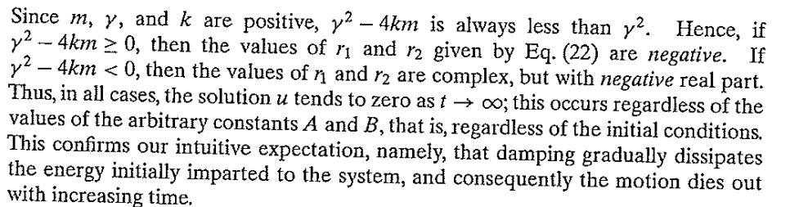
OBSERVATION :

Slide 17
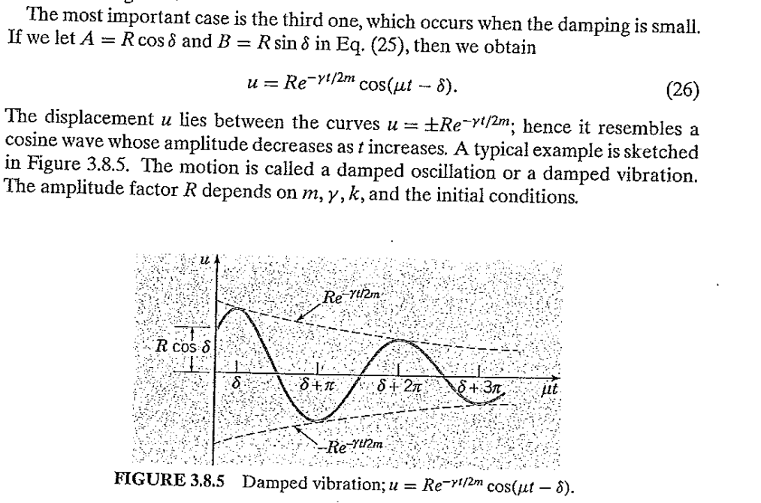

Slide 18
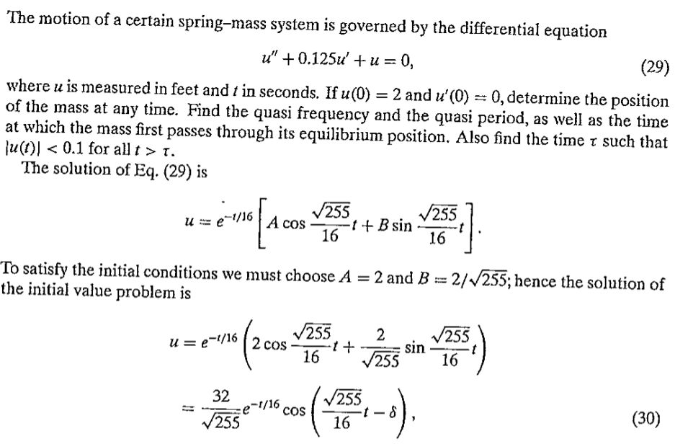

EXAMPLE :

Slide 19
